Slide 1
1. What is Kubernetes?
Kubernetes is a free and open-source technology for automating the deployment, scaling and management of containerized applications that first released in 2014 by google. Its being used by almost all major CSP (cloud service provider), like AWS, GCP, Azure etc.
2. What is a container and why it is used in Kubernetes?
A container is nothing but a virtual machine that is running on a single physical server.
It is just a virtual machine that has been configured to provide a complete operating environment for your container.
A container provides a complete operating system and all the applications and libraries that are required to run a software application.
So, if you want to build a software application, you need to install the dependencies in the container, and if you want to run the application then you need to install the containers in the host machine.
This is the basic concept of a container and Kubernetes uses this concept to manage the applications.

Slide 2
What is the features of Kubernetes?
Automation
One of the main reasons for using Kubernetes is to automate the process of creating, deploying, managing and monitoring the containers.
This allows the developers to focus on their primary task, which is writing the code. Kubernetes does all the work for them.
This automation also allows the developers to scale their applications as per their needs.
Kubernetes supports many tools that make it easy for the developers to deploy, scale and manage the applications.
Scalability
Kubernetes can easily be scaled up or down to meet the requirements of a cloud-based service provider.
Kubernetes supports horizontal scaling, which means that you can add more machines to a cluster to increase the number of containers.
The Kubernetes architecture is highly scalable.
Cost savings:
Kubernetes is a free and open-source project. It is being used by many cloud providers to run their container-based workloads.
As it is a free tool, you don’t have to pay for the licensing fees of the software. So, you can save a lot of money by using the free version of the tool.

Slide 3
4. Kubernetes observability and monitoring:
Kubernetes is one of the most popular container management systems available today.
The rise of container technology has increased the demand for containers within organizations.
Because of this, Kubernetes adoption is on the rise, and so is the demand for Kubernetes security.
For example, companies like Google, Azure, Netflix, and Amazon are using Kubernetes extensively.
In fact, Kubernetes is the leading platform for container orchestration and management. As such, there are a number of tools that you can use to monitor Kubernetes. Such as - CloudWatch, Azure monitoring, Grafana, Prometheus etc.
5. Kubernetes backup:
One of the most important ways to secure your Kubernetes clusters is to back up your data.
Kubernetes is a highly-available system, which means that it’s not very easy to recover your data if a failure occurs.
For example, if you’re using Kubernetes on AWS Cloud, you can use the Elastic Kubernetes Service (EKS) to create a cluster.
If you’re using a public cloud, you can use Cloud Backup to backup your Kubernetes cluster. Why backup necessary?
There are a number of reasons why you should consider backing up your Kubernetes clusters:
You can restore your data easily if a failure occurs.
You can create a daily backup schedule to ensure that your data is backed up.
You can restore your data from the backup.

Slide 4
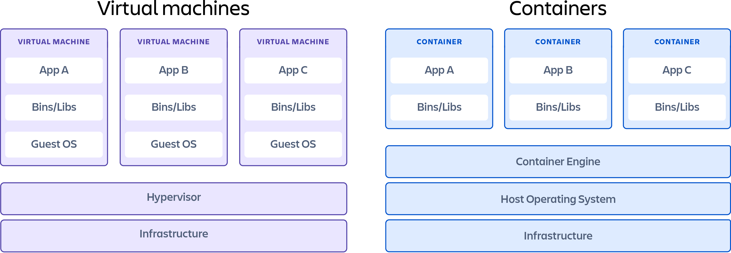
5. Different between container and VM:
Container: Containers are lightweight software packages that contain all the dependencies required to execute the contained software application. These dependencies include things like system libraries, external third-party code packages, and other operating system level applications. The dependencies included in a container exist in stack levels that are higher than the operating system. Such as: Docker, Linux container, RKT etc.
Virtual machine: Virtual machines are heavy software packages that provide complete emulation of low-level hardware devices like CPU, Disk and Networking devices. Virtual machines may also include a complementary software stack to run on the emulated hardware. These hardware and software packages combined produce a fully functional snapshot of a computational system. Such as: Vmware, Virtualbox etc.

Slide 5
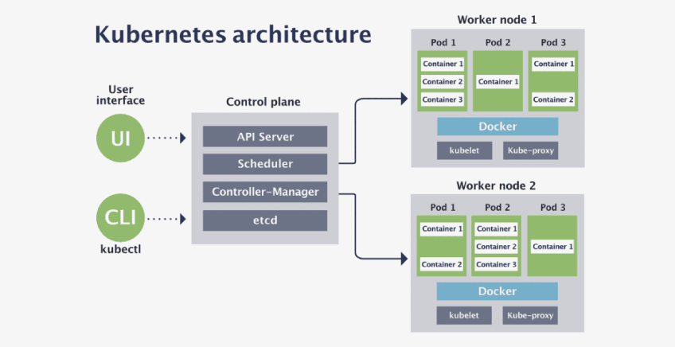
6. Kubernetes functional architecture with various components:

Slide 6
7. What is Kubernetes components:
Kubernetes consists of many components that make different clusters to facilitate container management. Kubernetes lets one create, deploy, and manage several applications across different host clusters with the help of a few components. Kubernetes control plane components are considered a main component of Kubernetes. It consists of different cluster nodes and at least one working node. Overall, Kubernetes has two groups of components as follows:
Control plane
Data plane / worker nodes
Control plane: Control plane manages Kubernetes clusters and the workloads running on them. Include components like the API Server, Scheduler, and Controller Manager.
Data plane / worker nodes: Data plane machines that can run containerized workloads. Each node is managed by the kubelet, an agent that receives commands from the control plane.
8. Control plane components:
Kube API server: Provides an API that serves as the front end of a Kubernetes control plane. It is responsible for handling external and internal requests—determining whether a request is valid and then processing it.
Kube-scheduler: This component is responsible for scheduling pods on specific nodes according to automated workflows and user defined conditions, which can include resource requests, concerns like affinity and taints or tolerations, priority, persistent volumes (PV), and more.

Slide 7
c.
Kube controller manager: The Kubernetes controller manager is a control loop that monitors and regulates the state of a Kubernetes cluster. It receives information about the current state of the cluster and objects within it and sends instructions to move the cluster towards the cluster operator’s desired state. The controller manager is responsible for several controllers that handle various automated activities at the cluster or pod level, including replication controller, namespace controller, service accounts controller, deployment, statefulset, and daemonset.
Etcd: A key-value database that contains data about your cluster state and configuration. Etcd is fault tolerant and distributed.
Cloud-controller-manager: This component can embed cloud-specific control logic - for example, it can access the cloud provider’s load balancer service. It enables you to connect a Kubernetes cluster with the API of a cloud provider. Additionally, it helps decouple the Kuberneters cluster from components that interact with a cloud platform, so that elements inside the cluster do not need to be aware of the implementation specifics of each cloud provider.
d.
e.
9. Data plane components:
Nodes: Nodes are physical or virtual machines that can run pods as part of a Kubernetes cluster. A cluster can scale up to 5000 nodes. To scale a cluster’s capacity, you can add more nodes.
Pods: A pod serves as a single application instance, and is considered the smallest unit in the object model of Kubernetes. Each pod consists of one or more tightly coupled containers, and configurations that govern how containers should run.
Container runtime engine: Each node comes with a container runtime engine, which is responsible for running containers. Docker is a popular container runtime engine, but Kubernetes supports other runtimes that are compliant with Open Container Initiative, including CRI-O and rkt.

Slide 8
d.
Kubelet: Each node contains a kubelet, which is a small application that can communicate with the Kubernetes control plane. The kubelet is responsible for ensuring that containers specified in pod configuration are running on a specific node, and manages their lifecycle.. It executes the actions commanded by your control plane.
Kube proxy: All compute nodes contain kube-proxy, a network proxy that facilitates Kubernetes networking services. It handles all network communications outside and inside the cluster, forwarding traffic or replying on the packet filtering layer of the operating system.
Container networking: Container networking enables containers to communicate with hosts or other containers. It is often achieved by using the container networking interface (CNI). CNI offers a standardized, minimal specification for network connectivity in containers.
e.
f.
Kubernetes persistent storage:
Containers are designed as immutable entities. Once a container is shut, all the data created during the container’s lifetime is lost. While this stateless characteristic is ideal for some applications, many use cases require preserving and sharing information. You can set up Kubernetes persistent storage to allow applications to consume and request storage resources. You can do this by using volumes, which serve as basic components of a Kubernetes storage architecture. PersistentVolumes (PVs) are storage resources designed to enable durable storage for containerized applications in Kubernetes. Each PV is a persistent storage component within the Kubernetes architecture. PV resources belong to the cluster but exist independently of pods. To ensure statefulness, each disk and data represented by PVs continue existing even as changes occur to the cluster, regardless of deletion and recreation of pods.

Slide 9
Kubernetes services:
A Kubernetes service can be used to easily expose an application deployed on a set of pods using a single endpoint. A service is both a REST object and an abstraction that defines:
A set of pods
A policy to access them
Pods in a Kubernetes deployment are regularly created and destroyed, causing their IP addresses to change constantly. It will create discoverability issues for the deployed, application making it difficult for the application frontend to identify which pods to connect.
This is where the strengths of Kubernetes services come into play: services keep track of the changes in IP addresses and DNS names of the pods and expose them to the end-user as a single IP or DNS
Some services:
ClusterIP: A ClusterIP service is the default type of service in Kubernetes. It creates a service inside the Kubernetes cluster, which can be accessed by other applications in the cluster, without allowing external access.
NodePort: A NodePort service opens a specific port on all the Nodes in the cluster, and any traffic sent to that port is forwarded to the service. The service cannot be accessed from the cluster IP
Load balancer: A LoadBalancer is a standard way to expose a Kubernetes service externally so it can be accessed over the internet. If you are using EKS this creates a Load Balancer with one IP address, which external users can access and are then forwarded to the relevant node in your Kubernetes cluster. A LoadBalancer can also be accessed in the same way as a ClusterIP or NodePort
Ingress: Ingress is actually not a type of service. It sits in front of multiple services and performs smart routing between them, providing access to your cluster. There are several types of ingress controllers that have different routing capabilities. In EKS, the ingress controller creates an HTTP Load Balancer, which can route traffic to services in the Kubernetes cluster based on path or subdomain.

Slide 10
12. Amazon ECR:
What is ECR?
Amazon Elastic Container Registry (Amazon ECR) is an AWS managed container image registry service that is secure, scalable, and reliable. Amazon ECR supports private repositories with resource-based permissions using AWS IAM. This is so that specified users or Amazon EC2 instances can access your container repositories and images. You can use your preferred CLI to push, pull, and manage Docker images, Open Container Initiative (OCI) images, and OCI compatible artifacts.
How Amazon ECR works?
Amazon Elastic Container Registry writes and packages code in the form of a Docker image.
Next, it compresses, encrypts and manages access to the images -- including all tags and versions -- and controls image lifecycles.
Finally, the Amazon ECS pulls the necessary Docker images from the ECR to be used in the deployment of apps and continues to manage containers everywhere -- including Amazon Elastic Kubernetes Service (Amazon EKS), AWS cloud and on-premise networks.
Components of Amazon ECR
Docker images: This is the file that is used to execute code within a Docker container.
Repository: The Docker images are stored in the Amazon ECR repository. Developers can push and pull images to the repository.
Repository policy: Developers can use these policies to manage access to the repositories and the images within them.
Registry: All AWS accounts receive access to Amazon ECR that allows them to create repositories and store images in them.
Authorization token: Before it can push and pull images, the Docker client must be recognized as an AWS account holder.
For more: https://docs.aws.amazon.com/AmazonECR/latest/userguide/what-is-ecr.html

Slide 11
Deploying EKS cluster using CLI tool (eksctl)
Prerequisites:
AWS account
A VPC
IAM user role with
Security group
Create cluster control plane
Cluster name
Version
Choose region
Choose VPC
Security group
Create worker node
Create a node group
Cluster attachment
Security group, Instance type
Auto scaling (Define max and min number of nodes/instances)

Slide 12
Hands on practice:
To install eksctl tool: (for Mac)
(eksctl is a simple CLI tool for creating and managing clusters on EKS - Amazon's managed Kubernetes service for EC2. It is written in Go, uses CloudFormation, was created by Weaveworks and it welcomes contributions from the community.)
brew tap weaveworks/tap
brew install weaveworks/tap/eksctl
eksctl version
Create EKS cluster:
To create cluster: eksctl create cluster --name izzanschool-cluster --version 1.25 --region us-east-1 --resources-vpc-config subnetIds= subnet-33272c54, subnet-dd5243f3 --nodegroup-name linux-nodes --node-type t2.micro --nodes 2 --nodes-min 1 --nodes-max 3 --managed--profile izzanschool
To connect to the cluster:
aws eks update-kubeconfig --kubeconfig kubeconfig --name izzanschool --region us-east-2 --profile=izzanschool
export KUBECONFIG="./kubeconfig”
Install “kubectl” tool: For Mac
(The Kubernetes command-line tool, kubectl, allows you to run commands against Kubernetes clusters. You can use kubectl to deploy applications, inspect and manage cluster resources, and view logs)
brew install kubectl
kubectl version –client
To learn kubectl command: https://kubernetes.io/docs/reference/kubectl/cheatsheet/
Delete the cluster and all associated resources:
eksctl delete cluster --region=us-east-2 --name=izzanschool --profile izzanschool

